Slide 1




Netflix Viewer Insight Analysis using Python and Pandas
Project by : Vidya Bhagat
Date : 24-July-25

Slide 2
🎯 Project Objective
To analyze the content available on Netflix to understand trends in genre, content type, release years, and global distribution.

Slide 3






A Netflix Content Analysis
Introduction
This analysis explores the Netflix Life Impact Dataset (NLID), which captures how specific Netflix movies have influenced viewers' lives. The dataset includes details like movie genres, release years, audience ratings, notable life-changing moments, discovery methods, and meaningful advice taken from the films. By examining trends in ratings, genres, discovery channels, and viewer recommendations, this study aims to uncover what makes certain movies truly impactful and memorable.
Dataset Description The Netflix Life Impact Dataset (NLID) contains information on movies that had a significant emotional or motivational impact on viewers. It includes movie titles, genres, release years, average ratings, number of reviews, key life-changing moments (timestamps), how viewers discovered the movie, meaningful advice taken, and the percentage of viewers who recommended the movie to others.
Dataset Visualization Data visualization in this analysis uses charts and graphs to clearly show patterns in the Netflix Life Impact Dataset. Visuals like bar charts, pie charts, and histograms highlight trends in genres, ratings, discovery methods, life-changing moments, and viewer recommendations, making it easier to understand how movies impact audiences.
Conclusion The analysis shows that highly rated movies across genres like drama, documentary, and sci-fi have a strong life impact on viewers. Most people discovered these films through friends or social media, and meaningful lessons like persistence, kindness, and self-awareness were commonly taken away. Overall, emotional storytelling and personal recommendations play a key role in making movies life-changing.

Slide 4







1. Genre Popularity and Impact
6.Recommendation Rate
5. Movie Discovery Source
2. Average Rating Movie
3. Life changing movements
4. Meaningful advice taken
Analysis

Slide 5
📄 Dataset Overview
The dataset is a curated collection of viewer responses about Netflix content.
It includes attributes such as:
Title, Genre, Release Year
Average Ratings & Number of Reviews
Review Highlights & Life-Changing Moments
Discovery Source (e.g., Social Media, Friends)
Advice Taken and Recommendation Rate

Slide 6
📊 Netflix Dataset: Column Descriptions
📄 Netflix Dataset: Column Information
Column Name | Description
Movie Title | Title of the movie or show
Genre | Genre or category (e.g., Drama, Documentary, Thriller/Drama)
Release Year | The year the content was released
Average Rating | Average user rating (likely out of 10)
Number of Reviews | Total number of user reviews submitted
Review Highlights | Selected user review quotes or feedback
Minute of Life-Changing Insight | Timestamp in the movie that had a powerful, emotional, or inspirational impact
How Discovered | How the viewer found or was recommended the content (e.g., friend, social media, Netflix recommendation)
Meaningful Advice Taken | Personal life lesson or advice the viewer took from the content
Suggested to Friends/Family (Y/N %) | Percentage of users who recommended it to friends/family (e.g., "92% Y")

Slide 7
🌐 Source Information
The dataset was manually compiled for educational and analytical purposes.
It may have originated from:
User surveys
Movie review platforms
Viewer experience reports
It is not an official Netflix dataset but reflects real-life viewer insights.

Slide 8
✅ Purpose
Used for data analysis, visual storytelling, and extracting actionable viewer insights.
Helps analyze emotional and social impact of popular Netflix titles.

Slide 9
🖼️ Data Cleaning Pipeline
🗃️ Raw Data ➡️ ⚠️ Issues Found ➡️ 🧹 Cleaning Done ➡️ 📊 Cleaned Data
🎯 Objective:
Show how raw data was processed into clean, structured data before analysis using a visual flow.
➡️ Raw Data
Unstructured text
Mixed formats (e.g., "85% Y", "1:12:00 – scene")
Combined fields like genres
➡️ Cleaning Applied
Parsed % and time fields
Split genres into separate tags
Standardized discovery sources
➡️ Identified Issues
Non-numeric values
Multi-value columns
Inconsistent labels
➡️ Cleaned Data
Structured & consistent
Ready for analysis with Pandas
Enabled accurate visual insights

Slide 10
➡️ “Data Insights & Visualizations using Pandas”

Slide 11
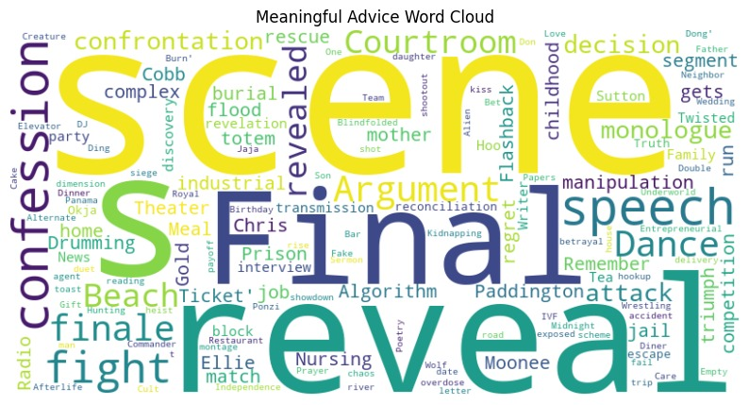
1.Word Cloud of Meaningful Advice
Visually show the core themes in what people are learning Highlight frequent topics like "self-love", "forgiveness", "courage", etc.

Slide 12
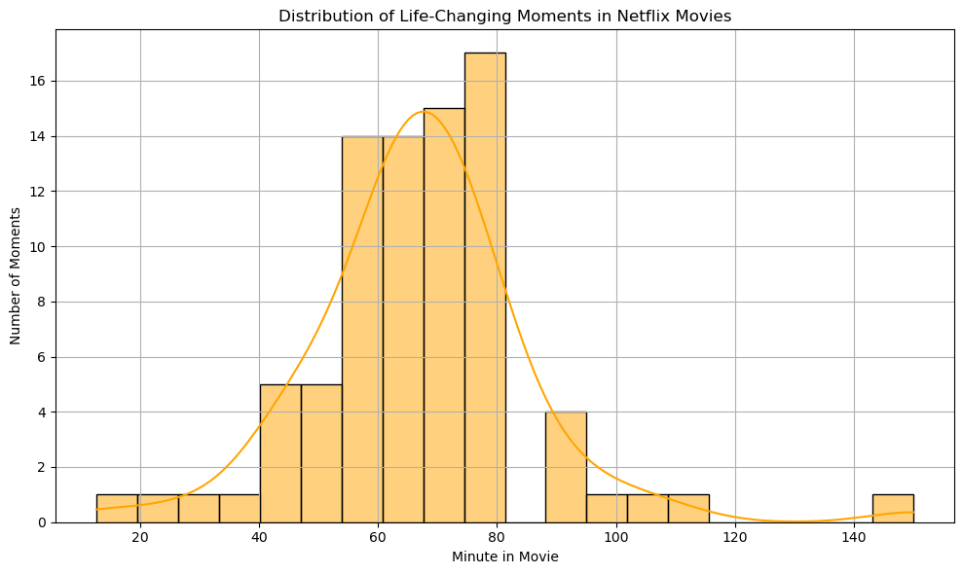
2.Distribution of Life-Changing Moments

Slide 13
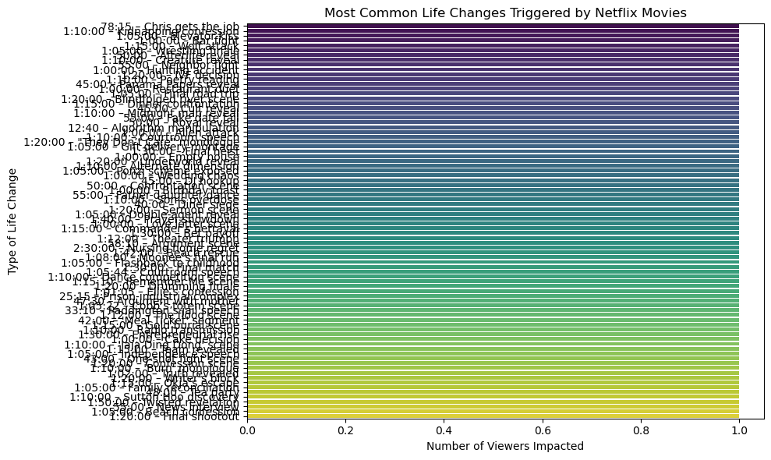
3. Life Changes Triggered by Movies
Top Life Changes Triggered by Movies

Slide 14
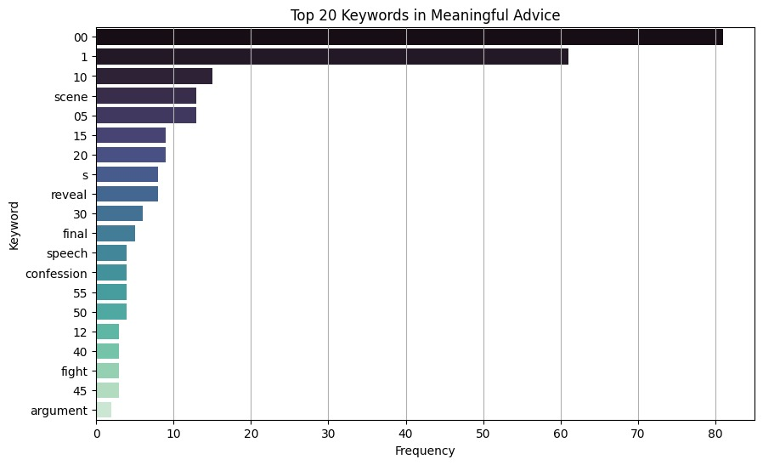
4. Top Keywords in Meaningful Advice

Slide 15
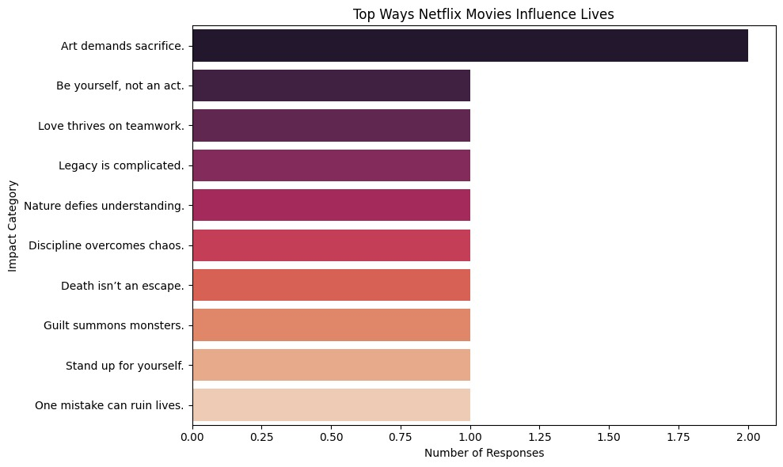
5. Chart of Most Common Impact Phrases

Slide 16
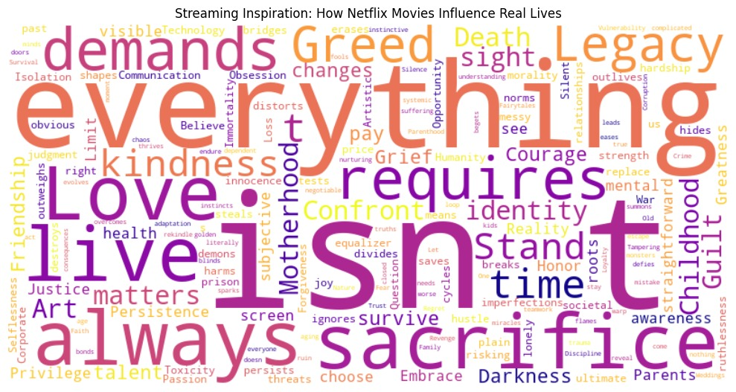
6.Word Cloud to Show Themes of Inspiration

Slide 17
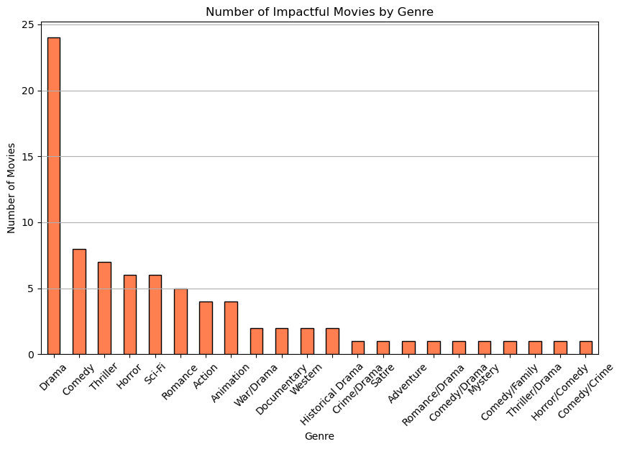
7. Genre Popularity And Impact
Which genre has the highest number of impactful movies?

Slide 18
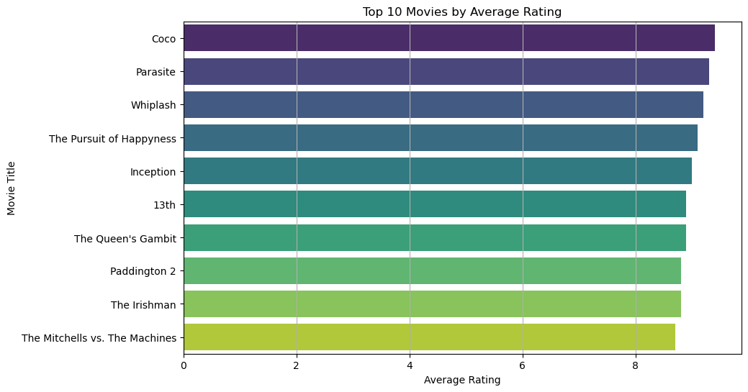
8. Average Movie Ratings
8.1 Average Rating distribution: How highly rated are these impactful movies?

Slide 19
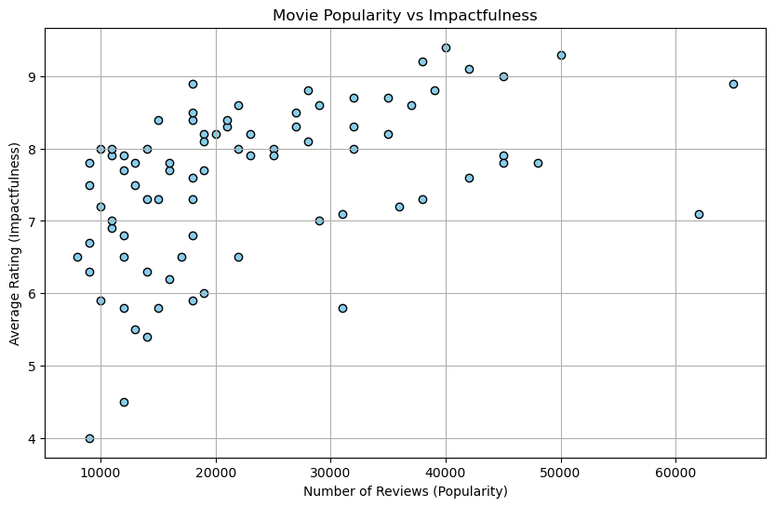
8.2 Average Rating distribution number of reviews(Popularity)

Slide 20
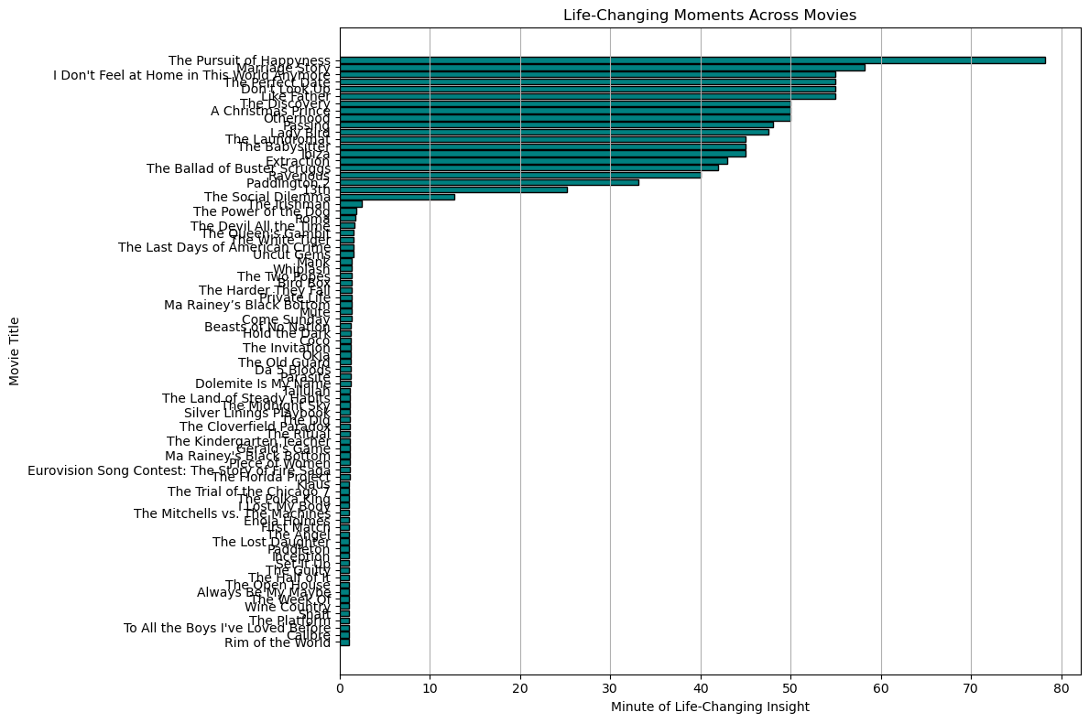
9. Life-Changing Moments
Is there a trend between the length of the movie and the timing of the life-changing moment?

Slide 21
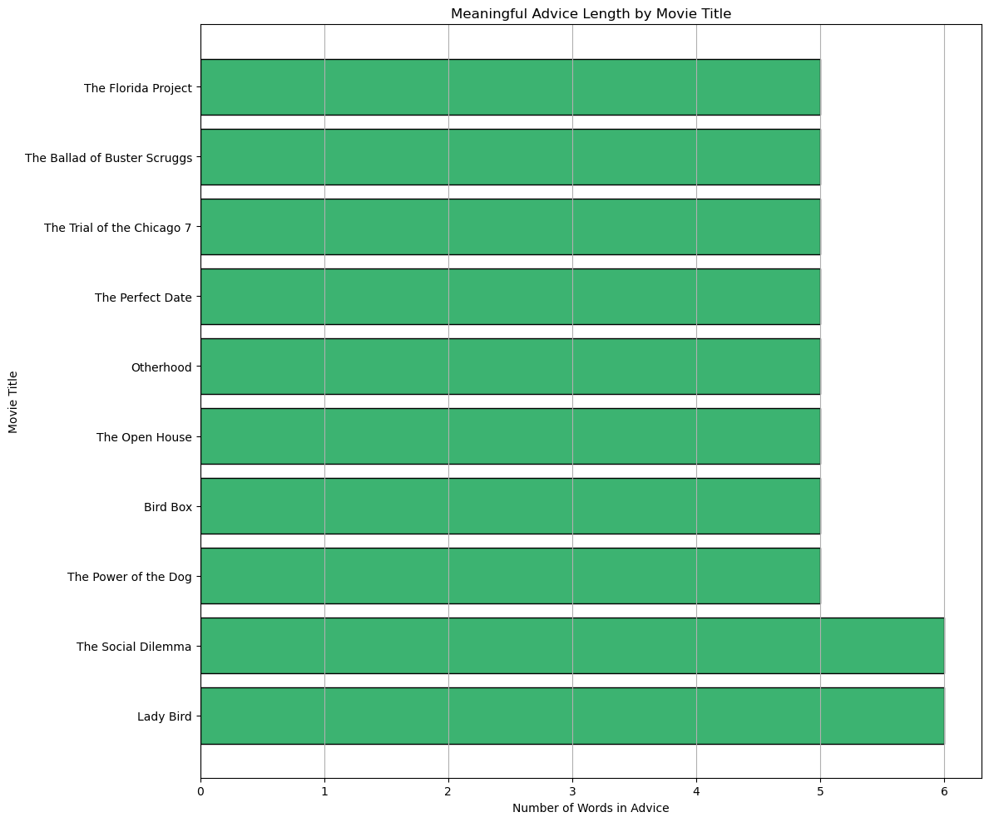
10. Meaningful advice taken
Highlight the nature and length of meaningful advice people gained from movies.

Slide 22
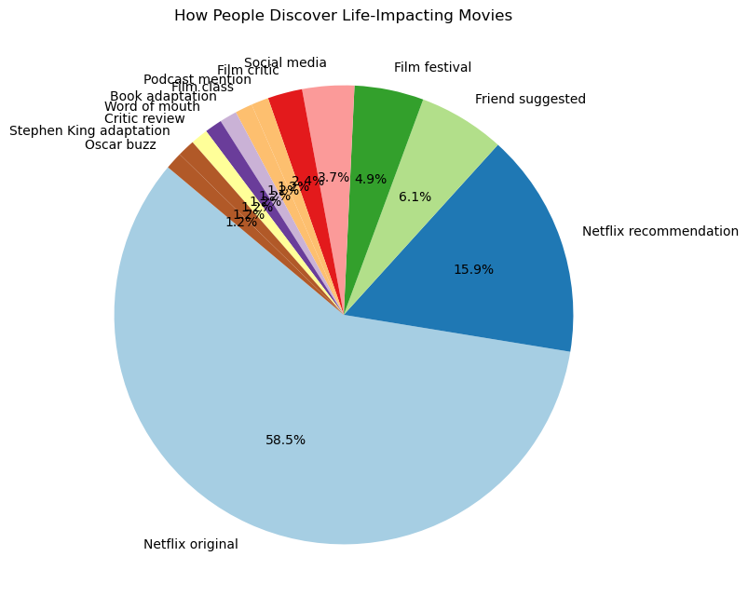
11. Movie Discovery Source
How people usually discover life-impacting movies.

Slide 23
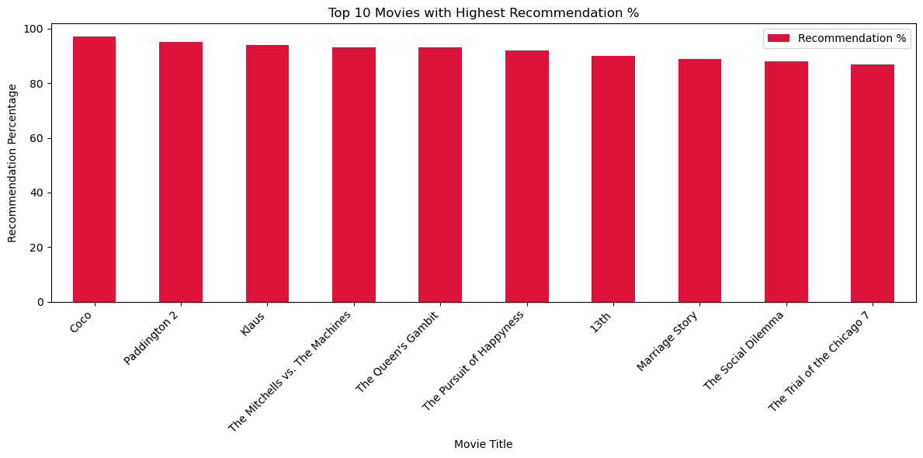
12. Recommendation Rate
Top 10 movies with highest recommendation %

Slide 24

Thank you

